Slide 1
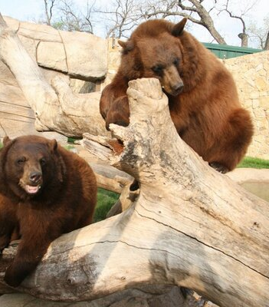
Baylor Brothers

Slide 2
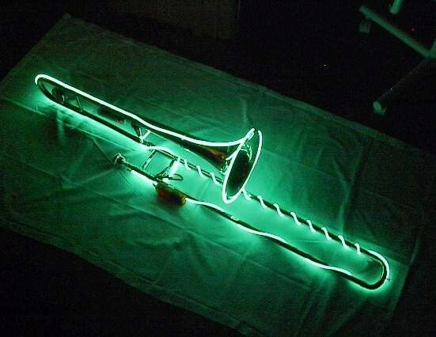
Matthias LeBrun
Hometown: Spring, TX
Major: Bioinformatics because I enjoy Biology and did not want to pursue a medical degree.
Interesting Fact:
I played trombone in high school.

Slide 3
Sheridan Seelson
Hometown: Killeen TX
Major Software Engineering / Comp Sci
Why? I just like science. I’ve always been interested in computing.
I write music (guitar)

Slide 4
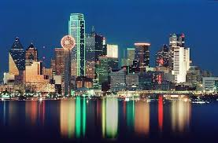
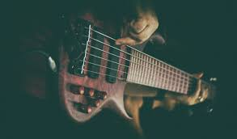
Isaiah Banda
From Dallas
Major : Computer Science because I'm interested in mobile applications.
Interesting: I like to play the guitar.

Slide 5
Andrew Kliewer
Hometown: Tulsa, OK
Major: Bioinformatics
Interested in sciences and wanted to do something unique for a degree
Comp Sci is also interesting
Interesting fact:
I played the saxophone

Slide 6
Daniel Ibarra
None

Slide 7
Progress
We have a object that can move on SDL Plotter
And a black background

Slide 8
Areas of Concern
Making a character
Time Management/Communication with group members
GitHub

